Slide 1


Big Data Infrastructure
CS 489/698 Big Data Infrastructure (Winter 2017)
Week 12: Real-Time Data Analytics (2/2)
March 30, 2016
Jimmy Lin
David R. Cheriton School of Computer Science
University of Waterloo
These slides are available at http://lintool.github.io/bigdata-2017w/
This work is licensed under a Creative Commons Attribution-Noncommercial-Share Alike 3.0 United States See http://creativecommons.org/licenses/by-nc-sa/3.0/us/ for details

Slide 2
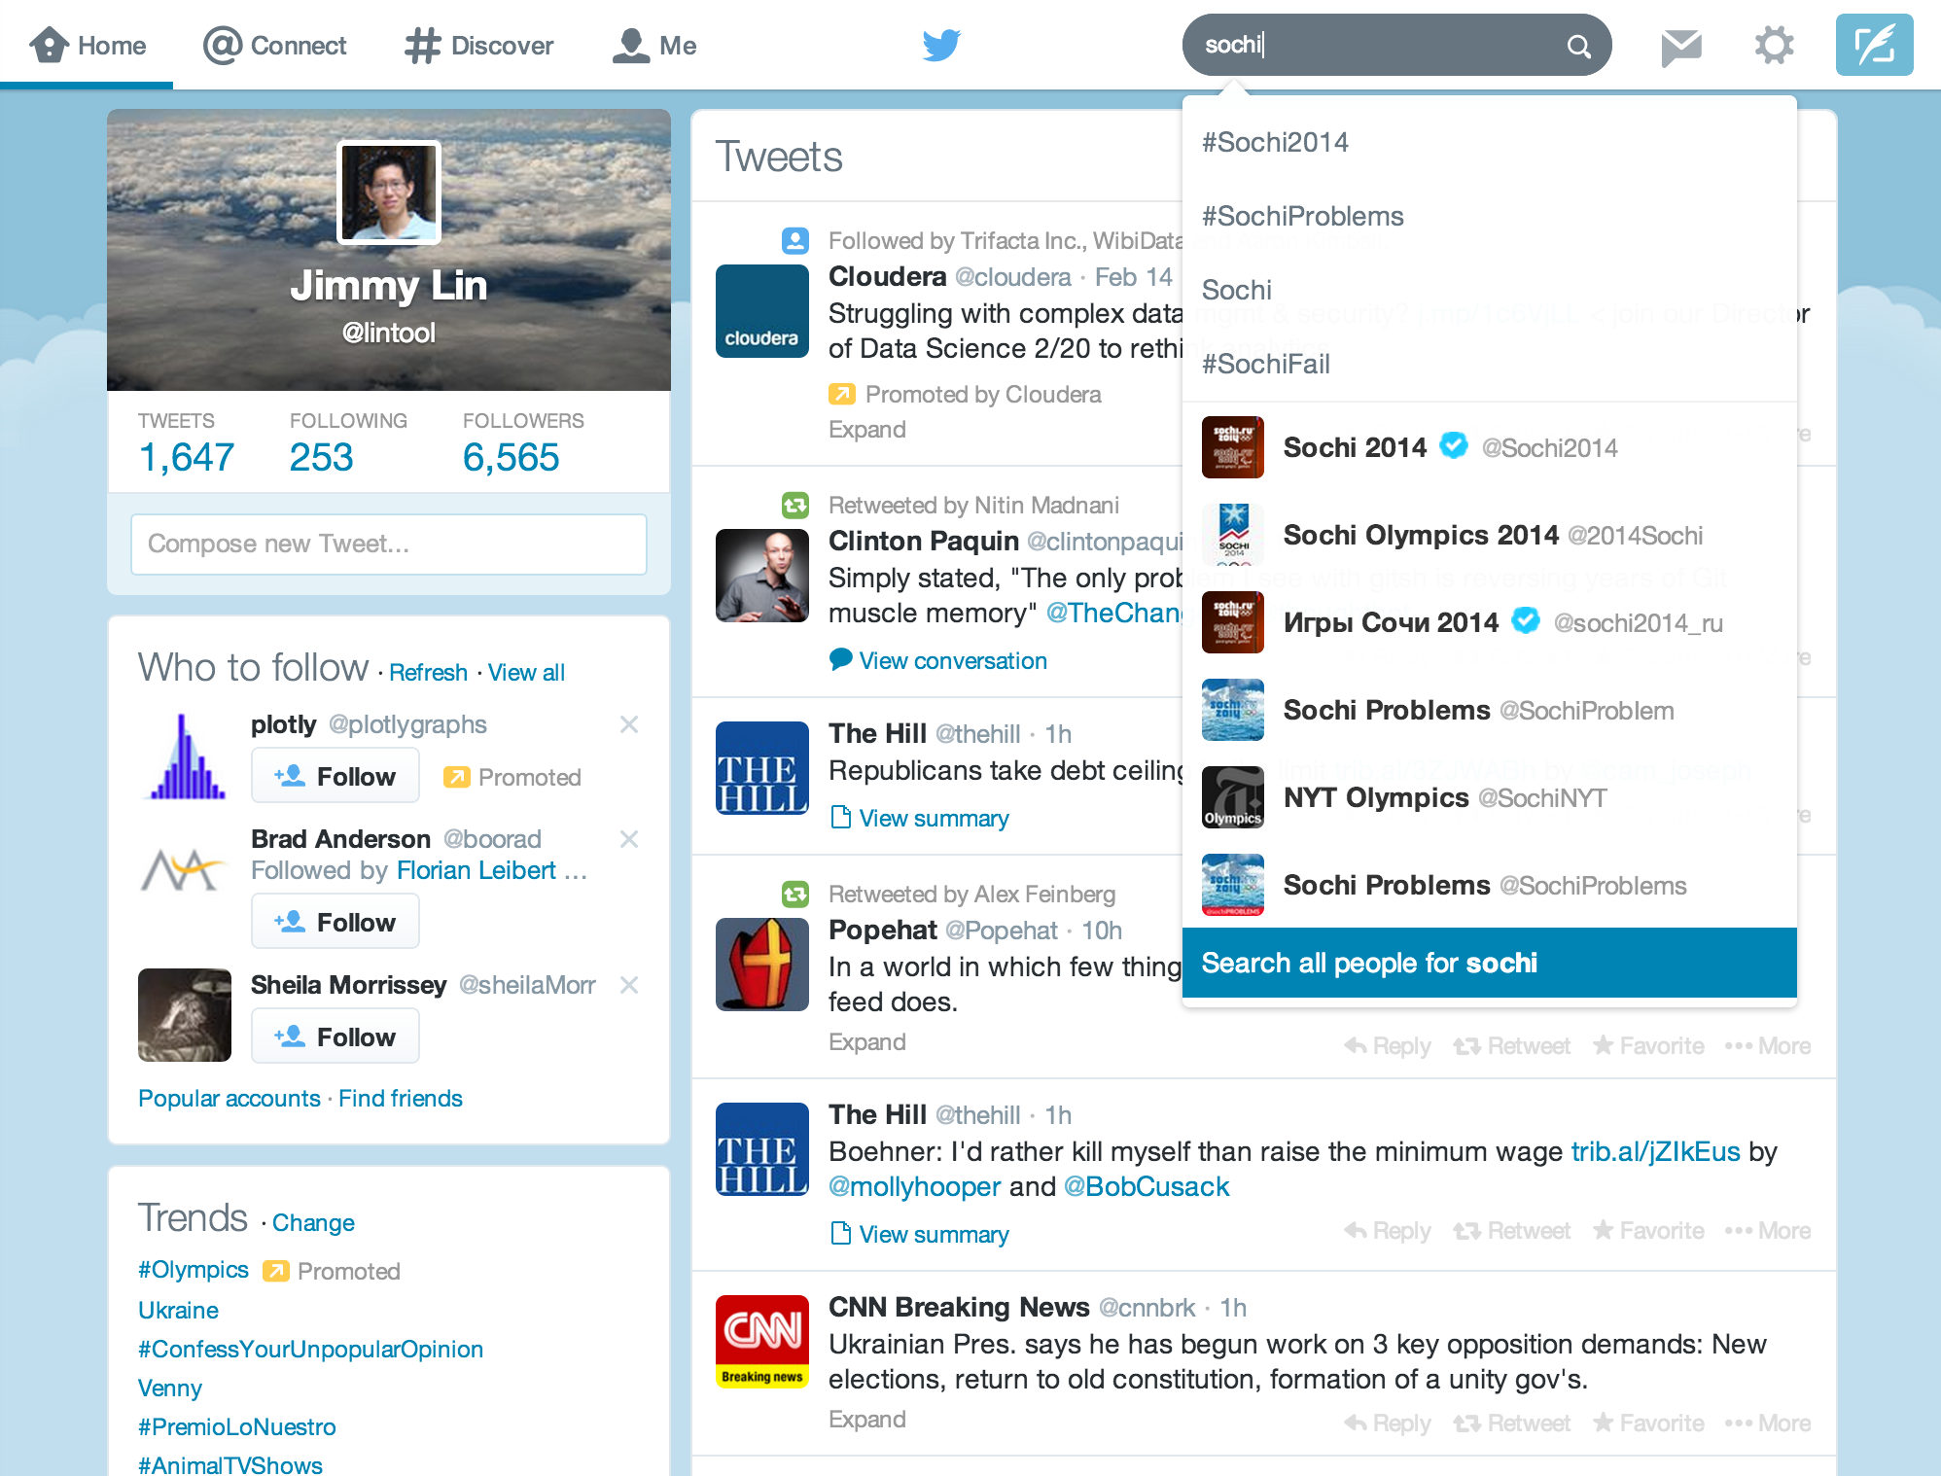
Mishne et al. Fast Data in the Era of Big Data: Twitter's Real-Time Related Query Suggestion Architecture. SIGMOD 2013.

Slide 3
Initial Implementation
Algorithm: Co-occurrences within query sessions
Implementation: Pig scripts over query logs on HDFS
Problem: Query suggestions were several hours old!
Why?
Log collection lag
Hadoop scheduling lag
Hadoop job latencies
We need real-time processing!

Slide 4
Solution?
Can we do better than one-off custom architectures?

Slide 5
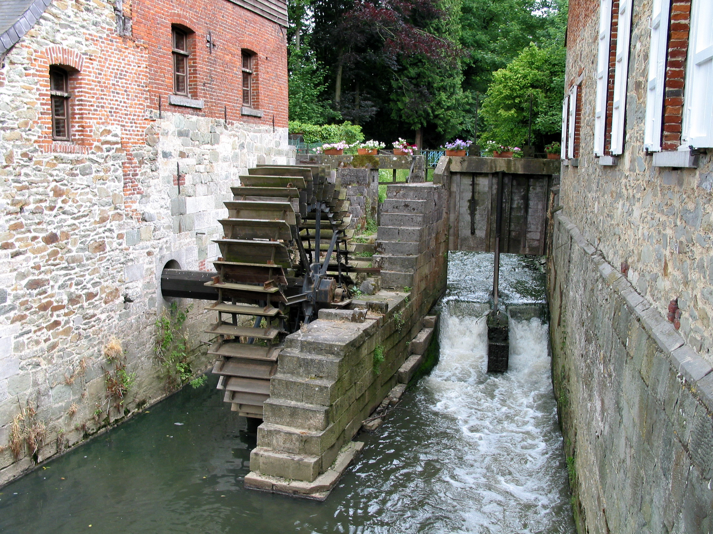
Stream Processing Architectures
Source: Wikipedia (River)

Slide 6
Producer/Consumers
Producer
Consumer
How do consumers get data from producers?

Slide 7
Producer/Consumers
Producer
Consumer
Producer pushes
e.g., callback

Slide 8
Producer/Consumers
Producer
Consumer
Consumer pulls
e.g., poll, tail

Slide 9
Producer/Consumers
Consumer
Producer
Consumer
Producer
Consumer
Consumer

Slide 10
Producer/Consumers
Consumer
Producer
Kafka
Broker
Consumer
Producer
Consumer
Consumer
Queue, Pub/Sub

Slide 11
Producer/Consumers
Consumer
Producer
Kafka
Broker
Consumer
Producer
Consumer
Consumer

Slide 12
Storm/Heron
Stream Processing Architectures
Source: Wikipedia (River)

Slide 13
Storm/Heron
Storm: real-time distributed stream processing system
Started at BackType
BackType acquired by Twitter in 2011
Now an Apache project
Heron: API compatible re-implementation of Storm
Introduced by Twitter in 2015
Open-sourced in 2016

Slide 14

Want real-time stream processing?
I got your back.
I’ve got the most intuitive implementation: a computation graph!

Slide 15
Topologies
Storm topologies = “job”
Once started, runs continuously until killed
A topology is a computation graph
Graph contains vertices and edges
Vertices hold processing logic
Directed edges indicate communication between vertices
Processing semantics
At most once: without acknowledgments
At least once: with acknowledgements

Slide 16
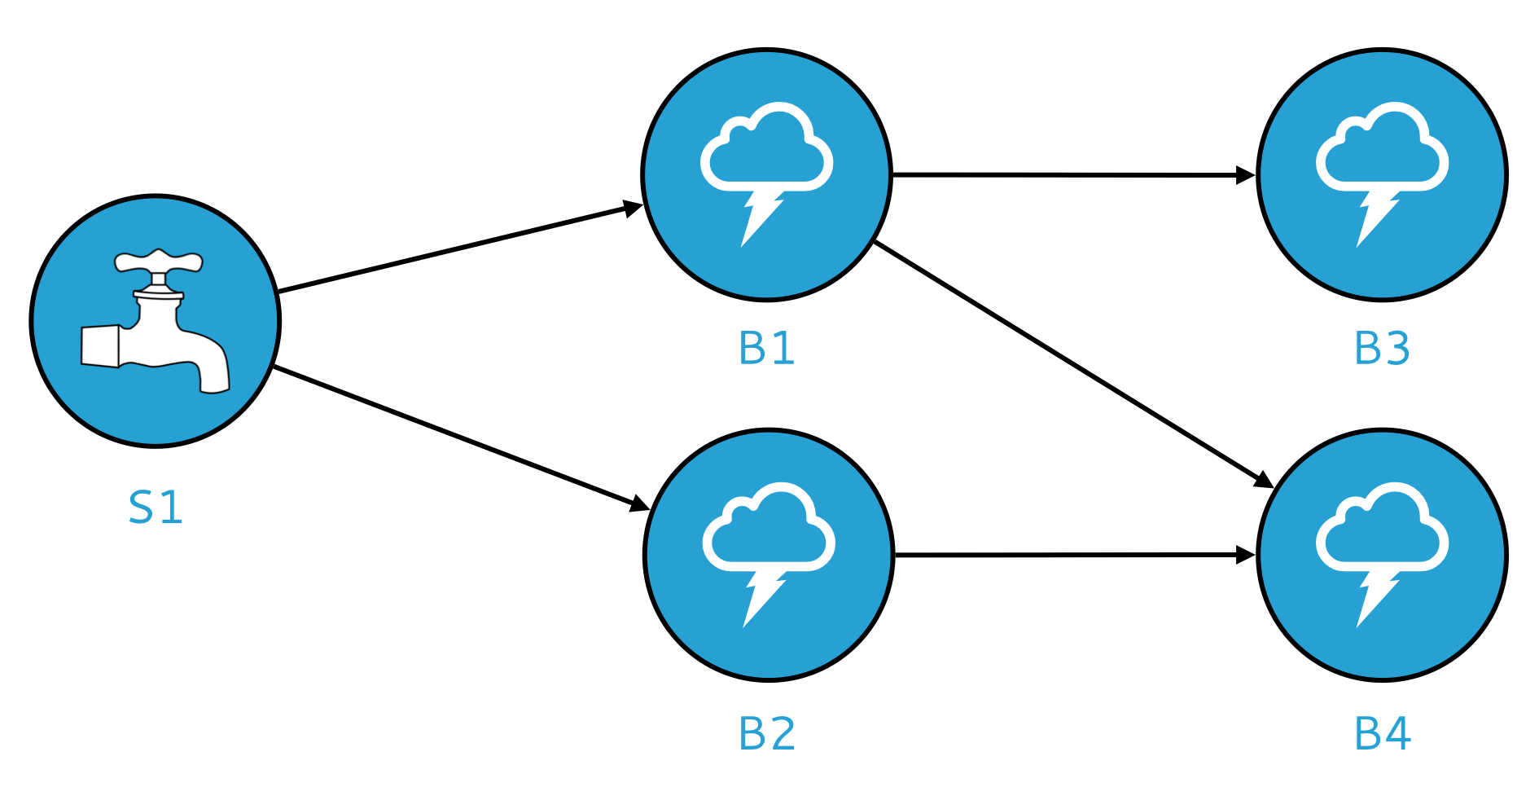
Spouts and Bolts: Logical Plan
Components
Tuples: data that flow through the topology
Spouts: responsible for emitting tuples
Bolts: responsible for processing tuples

Slide 17
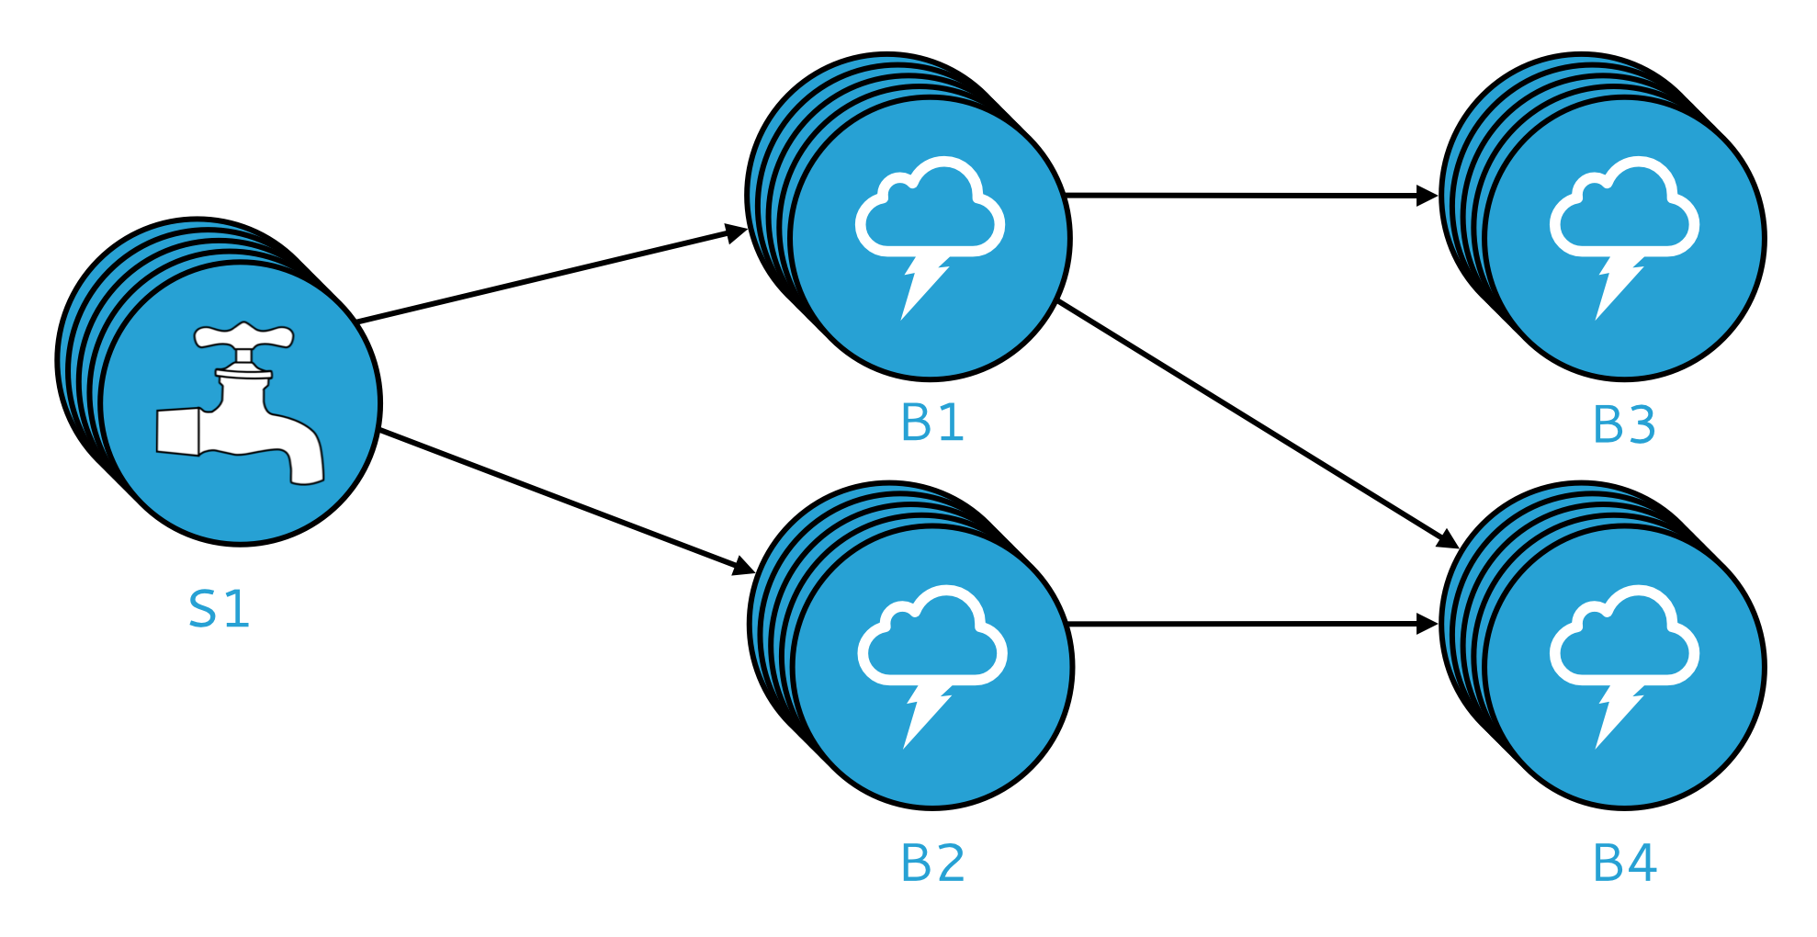
Spouts and Bolts: Physical Plan
Physical plan specifies execution details
Parallelism: how many instances of bolts and spouts to run
Placement of bolts/spouts on machines
…

Slide 18
Stream Groupings
Bolts are executed by multiple instances in parallel
User-specified as part of the topology
When a bolt emits a tuple, where should it go?
Answer: Grouping strategy
Shuffle grouping: randomly to different instances
Field grouping: based on a field in the tuple
Global grouping: to only a single instance
All grouping: to every instance

Slide 19
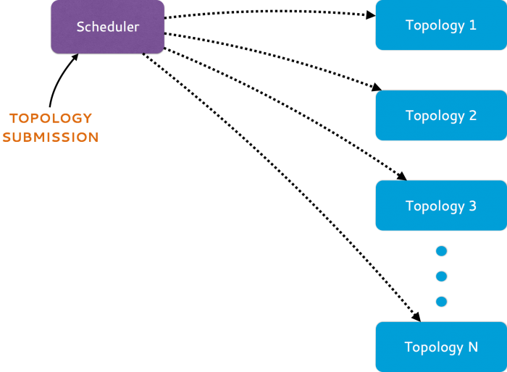
Heron Architecture
Source: https://blog.twitter.com/2015/flying-faster-with-twitter-heron

Slide 20
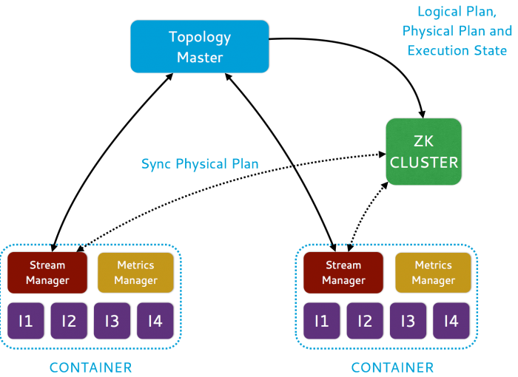
Heron Architecture
Source: https://blog.twitter.com/2015/flying-faster-with-twitter-heron

Slide 21
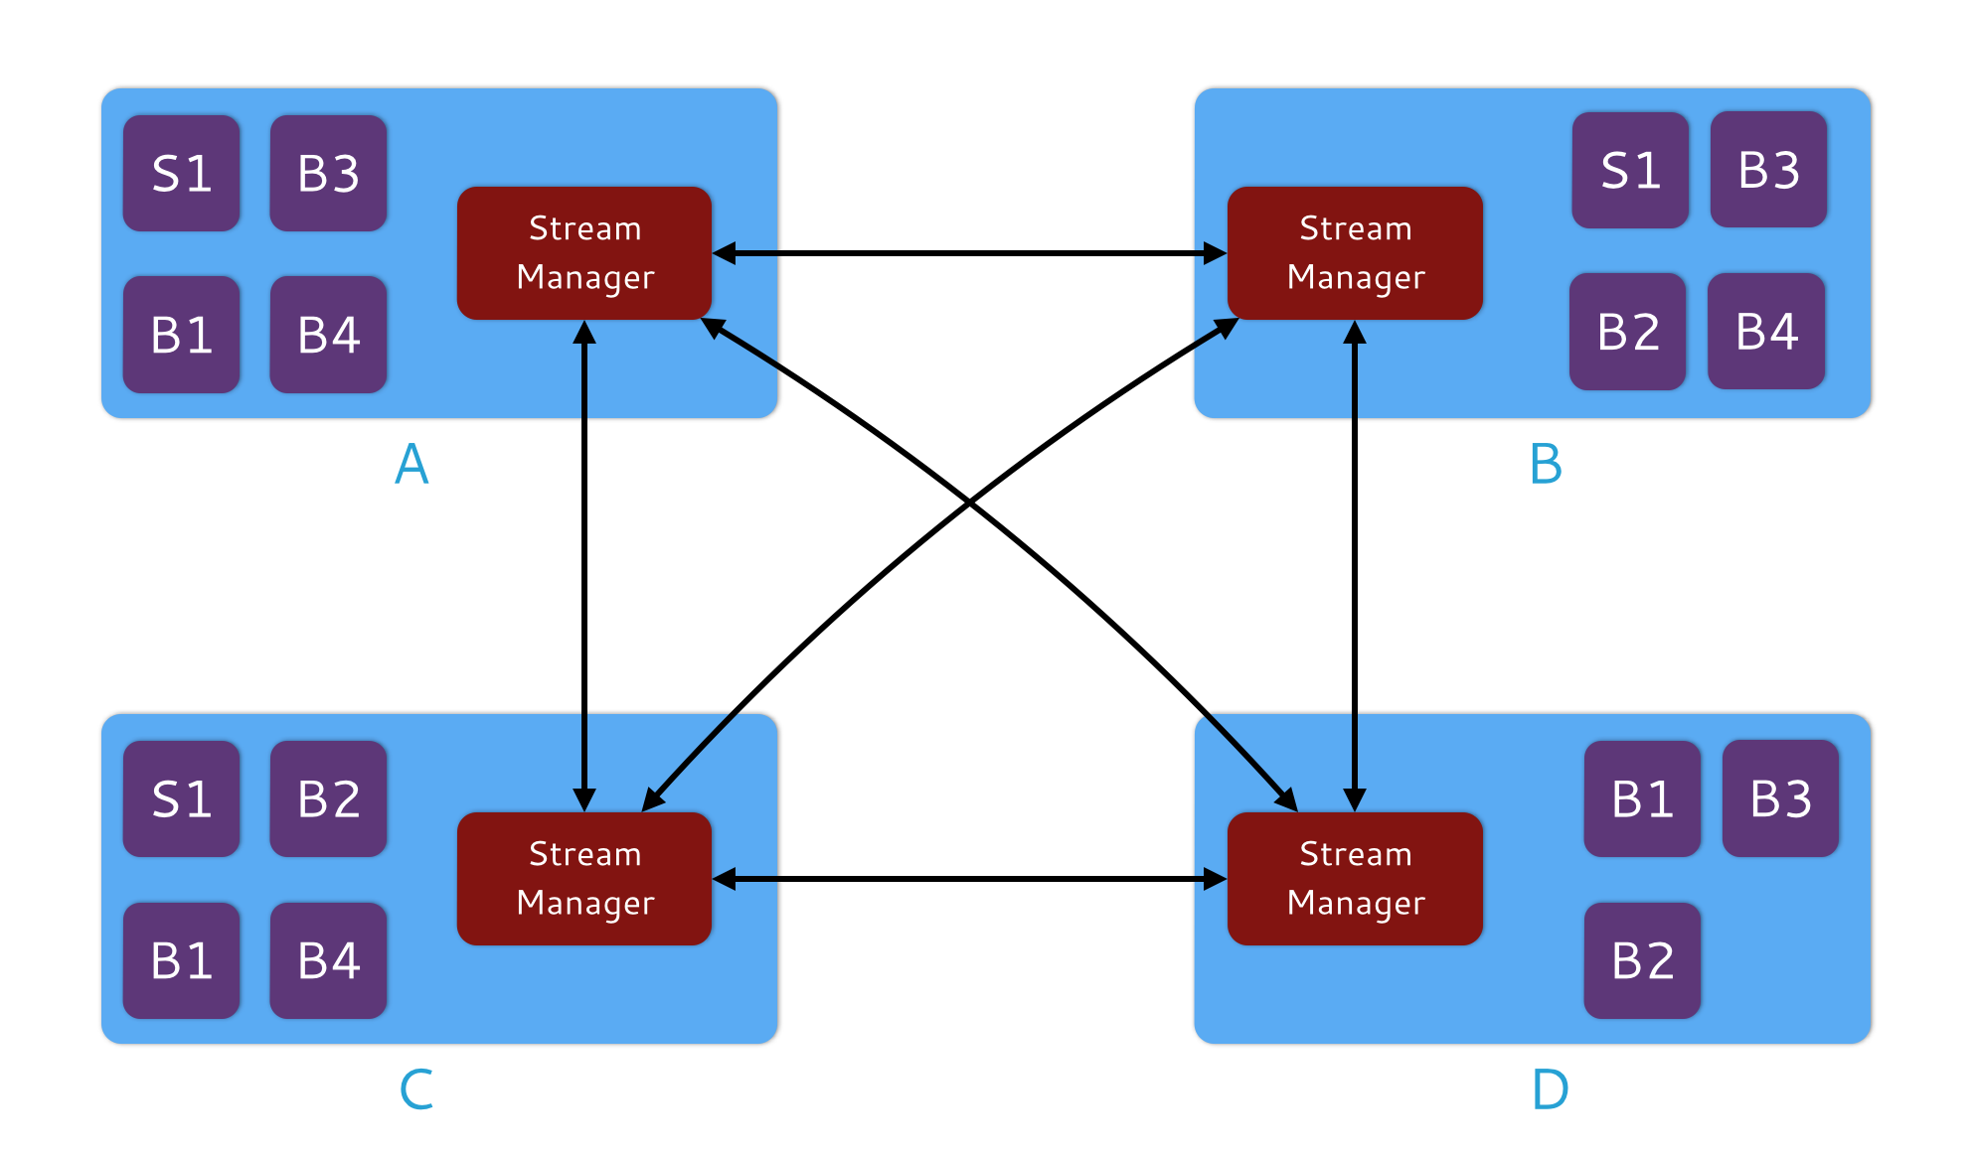
Heron Architecture
Stream Manager
Manages routing tuples between spouts and bolts
Responsible for applying backpressure

Slide 22
Some me some code!
TopologyBuilder builder = new TopologyBuilder();
builder.setSpout("word", new WordSpout(), parallelism);
builder.setBolt("consumer", new ConsumerBolt(), parallelism)
.fieldsGrouping("word", new Fields("word"));
Config conf = new Config();
// Set config here
// ...
StormSubmitter.submitTopology("my topology”, conf,
builder.createTopology());

Slide 23
Some me some code!
public static class WordSpout extends BaseRichSpout {
@Override
public void declareOutputFields(
OutputFieldsDeclarer outputFieldsDeclarer) {
outputFieldsDeclarer.declare(new Fields("word"));
}
@Override
public void nextTuple() {
// ...
collector.emit(word);
}
}

Slide 24
Some me some code!
public static class ConsumerBolt extends BaseRichBolt {
private OutputCollector collector;
private Map<String, Integer> countMap;
public void prepare(Map map, TopologyContext
topologyContext, OutputCollector outputCollector) {
collector = outputCollector;
countMap = new HashMap<String, Integer>();
}
@Override
public void execute(Tuple tuple) {
String key = tuple.getString(0);
if (countMap.get(key) == null) {
countMap.put(key, 1);
} else {
Integer val = countMap.get(key);
countMap.put(key, ++val);
}
}
}
What’s the issue?

Slide 25
Remember this?
Space: The Final Frontier
Data streams are potentially infinite
Unbounded space!
How do we get around this?
Throw old data away
Accept some approximation
General techniques
Sampling
Hashing
So what does Storm/Heron actually provide?

Slide 26
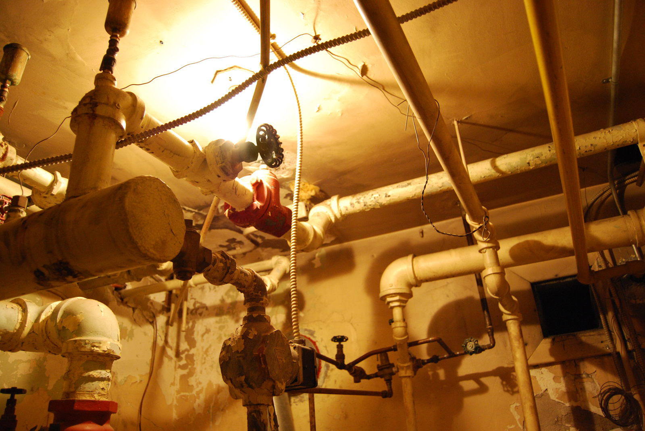
Source: Wikipedia (Plumbing)

Slide 27
Spark Streaming
Stream Processing Architectures
Source: Wikipedia (River)

Slide 28

Hmm, I gotta get in on this streaming thing…
But I got all this batch processing framework that I gotta lug around.
I know: we’ll just chop the stream into little pieces, pretend each is an RDD, and we’re on our merry way!
Want real-time stream processing?
I got your back.
I’ve got the most intuitive implementation: a computation graph!

Slide 29
Spark Streaming: Discretized Streams
Run a streaming computation as a series
of very small, deterministic batch jobs
Chop up the stream into batches of X seconds
Process as RDDs!
Return results in batches
live data stream
Spark
Streaming
batches of X seconds
Spark
processed results
Typical batch window ~1s
Source: All following Spark Streaming slides by Tathagata Das

Slide 30

Example: Get hashtags from Twitter
val tweets = ssc.twitterStream(<Twitter username>, <Twitter password>)
DStream: a sequence of RDD representing a stream of data
Twitter Streaming API
batch @ t+1
batch @ t
batch @ t+2
tweets DStream
stored in memory as an RDD (immutable, distributed)

Slide 31
Example: Get hashtags from Twitter
val tweets = ssc.twitterStream(<Twitter username>, <Twitter password>)
val hashTags = tweets.flatMap (status => getTags(status))
new DStream
transformation: modify data in one Dstream to create another DStream
batch @ t
batch @ t+1
batch @ t+2
tweets DStream
flatMap
flatMap
flatMap
hashTags Dstream
[#cat, #dog, … ]
…
new RDDs created for every batch

Slide 32
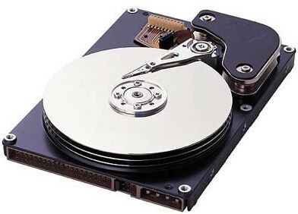
Example: Get hashtags from Twitter
val tweets = ssc.twitterStream(<Twitter username>, <Twitter password>)
val hashTags = tweets.flatMap (status => getTags(status))
hashTags.saveAsHadoopFiles("hdfs://...")
output operation: to push data to external storage
batch @ t
batch @ t+1
batch @ t+2
tweets DStream
flatMap
flatMap
flatMap
hashTags DStream
save
save
save
every batch saved to HDFS

Slide 33
Fault Tolerance
Bottom line: they’re just RDDs!

Slide 34
Fault Tolerance
Bottom line: they’re just RDDs!
tweets
RDD
input data replicated
in memory
flatMap
hashTags
RDD
lost partitions recomputed on other workers

Slide 35
Key Concepts
DStream – sequence of RDDs representing a stream of data
Twitter, HDFS, Kafka, Flume, ZeroMQ, Akka Actor, TCP sockets
Transformations – modify data from on DStream to another
Standard RDD operations – map, countByValue, reduce, join, …
Stateful operations – window, countByValueAndWindow, …
Output Operations – send data to external entity
saveAsHadoopFiles – saves to HDFS
foreach – do anything with each batch of results

Slide 36
Example: Count the hashtags
val tweets = ssc.twitterStream(<Twitter username>, <Twitter password>)
val hashTags = tweets.flatMap (status => getTags(status))
val tagCounts = hashTags.countByValue()
batch @ t
batch @ t+1
batch @ t+2
tweets
flatMap
flatMap
flatMap
hashTags
map
map
…
map
tagCounts
[(#cat, 10), (#dog, 25), ... ]
reduceByKey
reduceByKey
reduceByKey

Slide 37
Example: Count the hashtags over last 10 mins
val tweets = ssc.twitterStream(<Twitter username>, <Twitter password>)
val hashTags = tweets.flatMap (status => getTags(status))
val tagCounts = hashTags.window(Minutes(10), Seconds(1)).countByValue()
sliding window operation
window length
sliding interval

Slide 38
Example: Count the hashtags over last 10 mins
val tagCounts = hashTags.window(Minutes(10), Seconds(1)).countByValue()
t-1
t
t+1
t+2
t+3
hashTags
sliding window
countByValue
count over all the data in the window
tagCounts

Slide 39
Smart window-based countByValue
val tagCounts = hashtags.countByValueAndWindow(Minutes(10), Seconds(1))
t-1
t
t+1
t+2
t+3
hashTags
countByValue
add the counts from the new batch in the window
subtract the counts from batch before the window
–
+
tagCounts
+
?

Slide 40
Smart window-based reduce
Incremental counting generalizes to many reduce operations
Need a function to “inverse reduce” (“subtract” for counting)
val tagCounts = hashtags
.countByValueAndWindow(Minutes(10), Seconds(1))
val tagCounts = hashtags
.reduceByKeyAndWindow(_ + _, _ - _, Minutes(10), Seconds(1))
Final question: what’s the processing semantics of Spark Streaming?

Slide 41
Trident
Stream Processing Architectures
Source: Wikipedia (River)

Slide 42
Spouts and Bolts: Logical Plan

Slide 43
Heron Architecture
So what does Storm/Heron actually provide?

Slide 44
So what does Storm/Heron actually provide?
What do you really want?
Source: Wikipedia (Plumbing)

Slide 45
We need something like this!
TridentTopology topology = new TridentTopology();
TridentState wordCounts =
topology.newStream("spout1", spout)
.each(new Fields("sentence"), new Split(),
new Fields("word"))
.groupBy(new Fields("word"))
.persistentAggregate(new MemoryMapState.Factory(),
new Count(), new Fields("count"))
Also, would be nice to have exactly once semantics…
The answer: Trident!

Slide 46
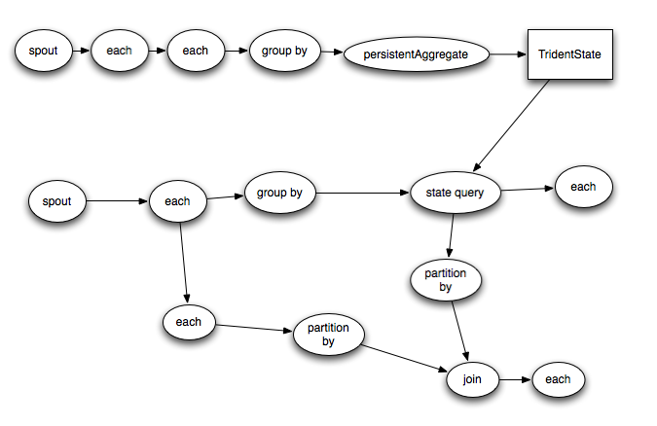
Trident
A high-level query graph…

Slide 47
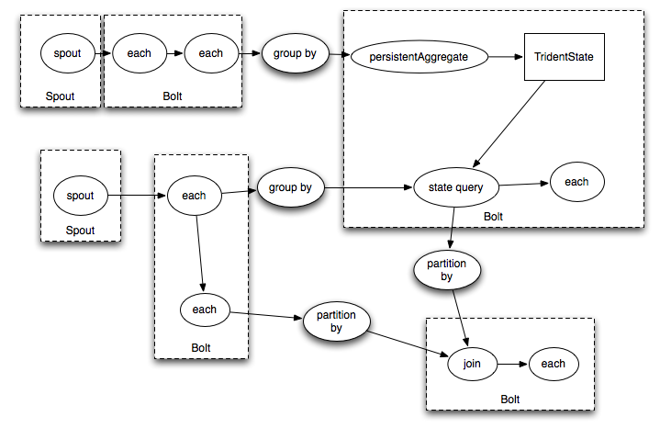
Trident
Compiles into a Storm topology

Slide 48
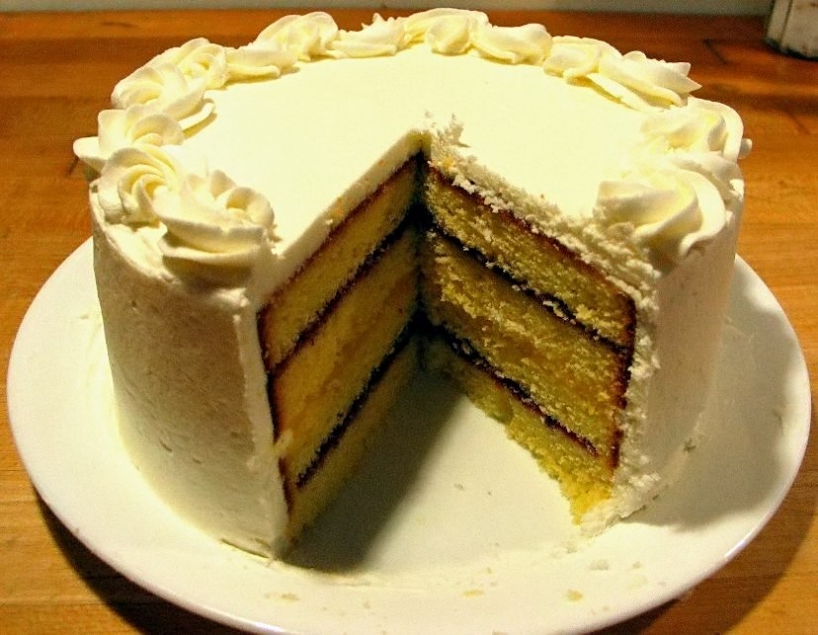
What about our cake?
Nice vision, but uptake unclear…
Source: Wikipedia (Cake)

Slide 49
Necessary Ingredients
Some reliable method of delivering data in real time
Kafka has become the de facto solution
Some underlying execution engine
Storm/Heron
Spark’s physical execution engine
Some high-level API or DSL
Trident for Storm/Heron
Spark Streaming for Spark

Slide 50
Summingbird
Stream Processing Architectures
Source: Wikipedia (River)

Slide 51

Summingbird
A domain-specific language (in Scala) designed
to integrate batch and online MapReduce computations
Idea #1: Algebraic structures provide the basis for seamless integration of batch and online processing
Idea #2: For many tasks, close enough is good enough
Probabilistic data structures as monoids
Boykin, Ritchie, O’Connell, and Lin. Summingbird: A Framework for Integrating
Batch and Online MapReduce Computations. PVLDB 7(13):1441-1451, 2014.

Slide 52
Batch and Online MapReduce
“map”
flatMap[T, U](fn: T => List[U]): List[U]
map[T, U](fn: T => U): List[U]
filter[T](fn: T => Boolean): List[T]
“reduce”
sumByKey

Slide 53
Idea #1: Algebraic structures provide the basis for seamless integration of batch and online processing
Semigroup = ( M , ⊕ )
⊕ : M ✕ M → M, s.t., ∀m₁, m₂, m₃ ∋ M
(m₁ ⊕ m₂) ⊕ m₃ = m₁ ⊕ (m₂ ⊕ m₃)
Monoid = Semigroup + identity
ε s.t., ε ⊕ m = m ⊕ ε = m, ∀m ∋ M
Commutative Monoid = Monoid + commutativity
∀m₁, m₂ ∋ M, m₁ ⊕ m₂ = m₂ ⊕ m₁
Simplest example: integers with + (addition)

Slide 54
Idea #1: Algebraic structures provide the basis for seamless integration of batch and online processing
Summingbird values must be at least semigroups (most are commutative monoids in practice)
Power of associativity =
You can put the parentheses anywhere!
( a ⊕ b ⊕ c ⊕ d ⊕ e ⊕ f )
Batch = Hadoop
((((( a ⊕ b ) ⊕ c ) ⊕ d ) ⊕ e ) ⊕ f )
Online = Storm
(( a ⊕ b ⊕ c ) ⊕ ( d ⊕ e ⊕ f ))
Mini-batches
Results are exactly the same!

Slide 55
Summingbird Word Count
where data comes from
def wordCount[P <: Platform[P]]
(source: Producer[P, String],
store: P#Store[String, Long]) =
source.flatMap { sentence =>
toWords(sentence).map(_ -> 1L)
}.sumByKey(store)
where data goes
“map”
“reduce”
Run on Scalding (Cascading/Hadoop)
read from HDFS
Scalding.run {
wordCount[Scalding](
Scalding.source[Tweet]("source_data"),
Scalding.store[String, Long]("count_out")
)
}
write to HDFS
Run on Storm
Storm.run {
wordCount[Storm](
new TweetSpout(),
new MemcacheStore[String, Long]
)
}
read from message queue
write to KV store

Slide 56
Input
Input
Input
Spout
Map
Map
Map
Bolt
Bolt
Bolt
Reduce
Reduce
Bolt
Bolt
Output
Output
memcached

Slide 57
“Boring” monoids
addition, multiplication, max, min
moments (mean, variance, etc.)
sets
tuples of monoids
hashmaps with monoid values
More interesting monoids?

Slide 58
“Interesting” monoids
Bloom filters (set membership)
HyperLogLog counters (cardinality estimation)
Count-min sketches (event counts)
Idea #2: For many tasks, close enough is good enough!

Slide 59
Cheat Sheet
Exact
Approximate
Set membership
set
Bloom filter
Set cardinality
set
hyperloglog counter
Frequency count
hashmap
count-min sketches

Slide 60
Example: Count queries by hour
Exact with hashmaps
def wordCount[P <: Platform[P]]
(source: Producer[P, Query],
store: P#Store[Long, Map[String, Long]]) =
source.flatMap { query =>
(query.getHour, Map(query.getQuery -> 1L))
}.sumByKey(store)
Approximate with CMS
def wordCount[P <: Platform[P]]
(source: Producer[P, Query],
store: P#Store[Long, SketchMap[String, Long]])
(implicit countMonoid: SketchMapMonoid[String, Long]) =
source.flatMap { query =>
(query.getHour,
countMonoid.create((query.getQuery, 1L)))
}.sumByKey(store)

Slide 61
Hybrid Online/Batch Processing
Example: count historical clicks and clicks in real time
Message Queue
read
Storm topology
write
online results key-value store
query
client
online
Summingbird
program
client library
batch
Hadoop job
batch results key-value store
query
ingest
HDFS
read
write
source₁
source₂
source₃
…
store₁
store₂
store₃
…

Slide 62
λ
(I hate this.)

Slide 63
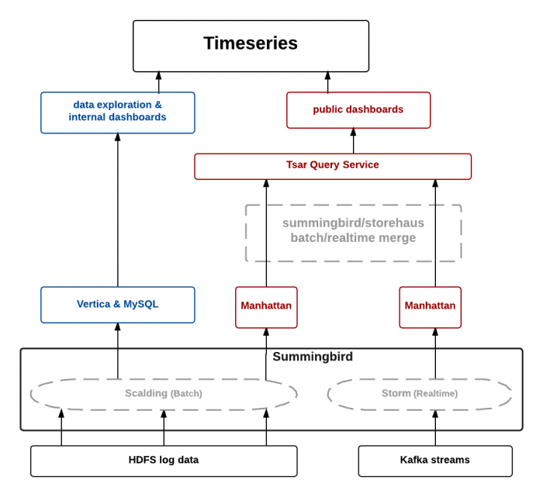
TSAR, a TimeSeries AggregatoR!
Source: https://blog.twitter.com/2014/tsar-a-timeseries-aggregator

Slide 64
Apache Beam
Stream Processing Architectures
Source: Wikipedia (River)

Slide 66
Apache Beam
2015: Google releases Cloud Dataflow
2016: Google donates API and SDK to Apache to become Apache Beam

Slide 67
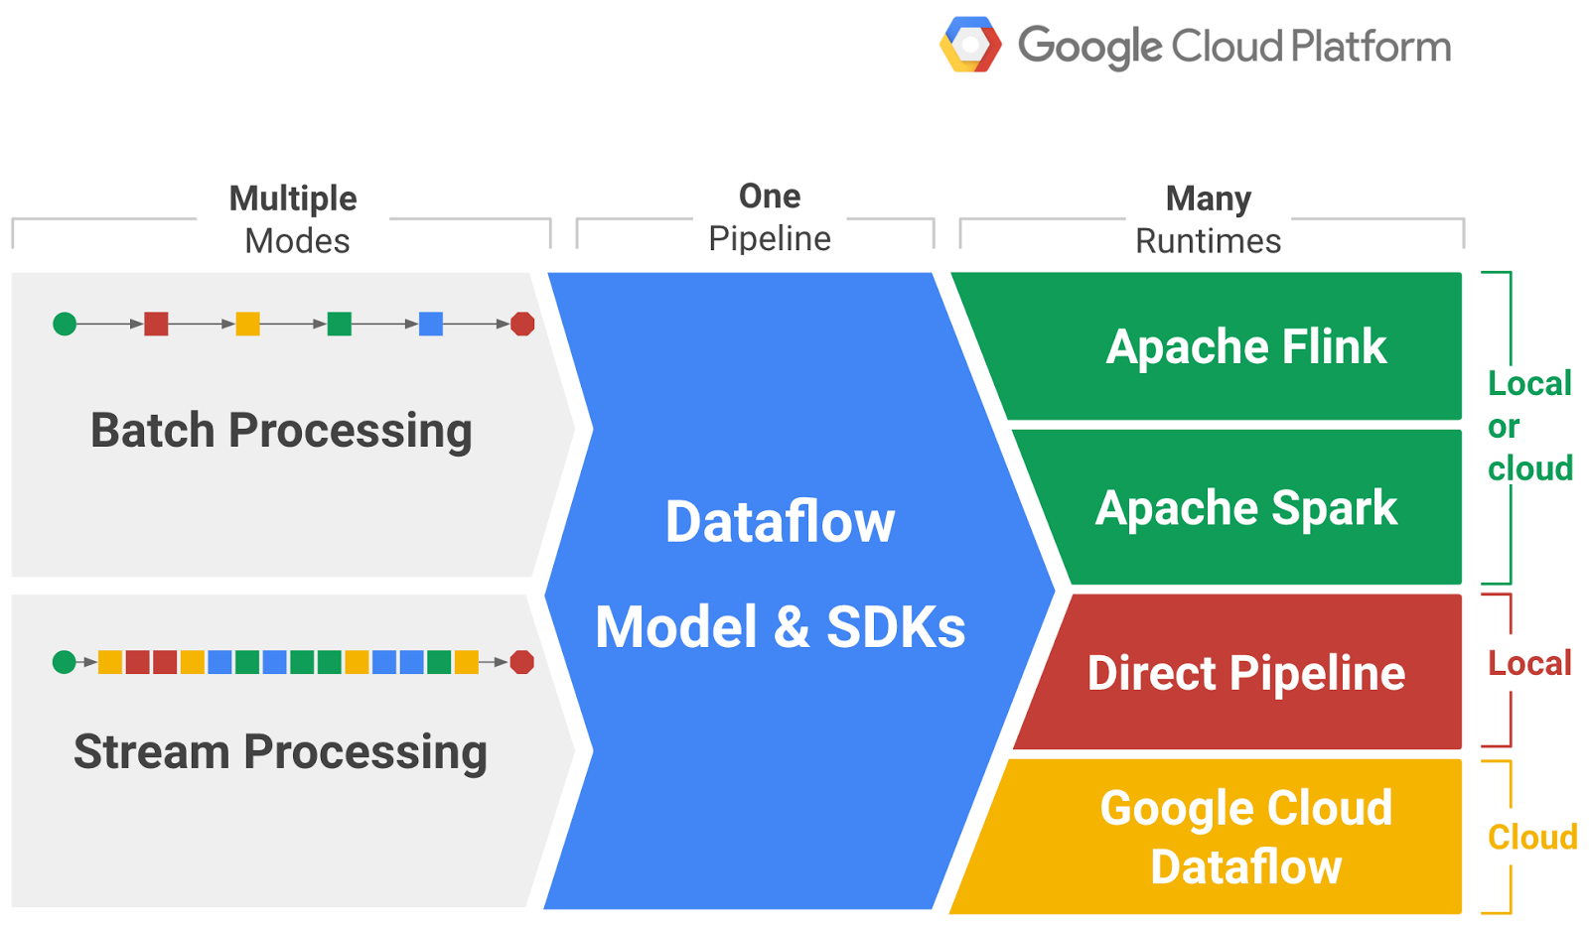
The Vision
Source: https://cloudplatform.googleblog.com/2016/01/Dataflow-and-open-source-proposal-to-join-the-Apache-Incubator.html

Slide 68
The Beam Model
What results are computed?
Where in event time are the results computed?
When in processing time are the results materialized?
How do refinements of results relate?

Slide 69
Programming Model
Fundamental distinction: bounded vs. unbounded datasets
Unbounded datasets need windowing
Core Concepts
Pipeline: a data processing task
PCollection: a distributed dataset that a pipeline operates on
Transform: a data processing operation
Source: for reading data
Sink: for writing data
Processing semantics: exactly once!

Slide 70
Processing Bounded Datasets
Pipeline p = Pipeline.create(options);
p.apply(TextIO.Read.from("gs://your/input/"))
.apply(FlatMapElements.via((String word) ->
Arrays.asList(word.split("[^a-zA-Z']+"))))
.apply(Filter.by((String word) -> !word.isEmpty()))
.apply(Count.perElement())
.apply(MapElements.via((KV<String, Long> wordCount) ->
wordCount.getKey() + ": " + wordCount.getValue()))
.apply(TextIO.Write.to("gs://your/output/"));

Slide 71
Event Time vs. Processing Time
What’s the distinction?
Watermark: System’s notion when all data in a window is expected to arrive
Where in event time are the results computed?
When in processing time are the results materialized?
How do refinements of results relate?
Trigger: a mechanism for declaring when output of a window should be materialized
Default trigger “fires” at watermark
Late and early firings: multiple “panes” per window

Slide 72
Event Time vs. Processing Time
What’s the distinction?
Watermark: System’s notion when all data in a window is expected to arrive
Where in event time are the results computed?
When in processing time are the results materialized?
How do refinements of results relate?
How do multiple “firings” of a window (i.e., multiple “panes”) relate?
Options: Discarding, Accumulating, Accumulating & retracting

Slide 73
Processing Bounded Datasets
Pipeline p = Pipeline.create(options);
p.apply(TextIO.Read.from("gs://your/input/"))
.apply(FlatMapElements.via((String word) ->
Arrays.asList(word.split("[^a-zA-Z']+"))))
.apply(Filter.by((String word) -> !word.isEmpty()))
.apply(Count.perElement())
.apply(MapElements.via((KV<String, Long> wordCount) ->
wordCount.getKey() + ": " + wordCount.getValue()))
.apply(TextIO.Write.to("gs://your/output/"));

Slide 74
Processing Unbounded Datasets
Pipeline p = Pipeline.create(options);
p.apply(KafkaIO.read("tweets")
.withTimestampFn(new TweetTimestampFunction())
.withWatermarkFn(kv ->
Instant.now().minus(Duration.standardMinutes(2))))
.apply(Window.into(FixedWindows.of(Duration.standardMinutes(2)))
.triggering(AtWatermark()
.withEarlyFirings(AtPeriod(Duration.standardMinutes(1)))
.withLateFirings(AtCount(1)))
.accumulatingAndRetractingFiredPanes())
.apply(FlatMapElements.via((String word) ->
Arrays.asList(word.split("[^a-zA-Z']+"))))
.apply(Filter.by((String word) -> !word.isEmpty()))
.apply(Count.perElement())
.apply(KafkaIO.write("counts"))
Where in event time?
When in processing time?
How do refines relate?

Slide 75
The Vision

Slide 76
versus
Hybrid Online/Batch Processing
Example: count historical clicks and clicks in real time
Message Queue
read
Storm topology
write
online results key-value store
query
client
online
Summingbird
program
client library
batch
Hadoop job
batch results key-value store
query
ingest
HDFS
read
write
source₁
source₂
source₃
…
store₁
store₂
store₃
…

Slide 77
The Central Value Proposition
Our stream processing engine is so fast that to do “batch” processing, just stream over bounded datasets.
Source: https://cloudplatform.googleblog.com/2016/01/Dataflow-and-open-source-proposal-to-join-the-Apache-Incubator.html

Slide 78
κ
(I hate this too.)
Everything is streaming!

Slide 79
What about our cake?
Source: Wikipedia (Cake)

Slide 80

The future?
Go help invent it and tell me about it!
Source: flickr (https://www.flickr.com/photos/39414578@N03/16042029002)

